Slide 1
Software Construction Laboratory CS35L – Lab 1
Course Webpage: https://web.cs.ucla.edu/classes/fall18/cs35L/index.html
TA: Zhiyi Zhang
Email: zhiyi@cs.ucla.edu
Webpage: https://zhiyi-zhang.com

Slide 2
Session 7-1
Linking
Static Linking
Dynamic Linking
Dynamic Loading
Attributes of Functions

Slide 3
Linking

Slide 4
Recall: Compilation and Linking
source
code
compiler
object
code
linker
executable
file
Translates programming language statements into cpu’s machine-language instructions
Preprocess
Compile
Assemble
Takes one or more object files generated by a compiler and combines them into a single executable file

Slide 5
Static Linking
Carried out only once to produce an executable file
If static libraries are called, the linker will copy all the modules referenced by the program to the executable
Static libraries are typically denoted by the .a file extension

Slide 6
Static Linking
source
code
compiler
object
code
linker
executable
file
object code from static library
A previously compiled collection of standard program functions

Slide 7
Dynamic Linking
Allows a process to add, remove, replace or relocate object modules during its execution
If shared libraries are called:
Only copy a little reference information when the executable file is created
Complete the linking during loading time or running time
Dynamic libraries are typically denoted by the .so file extension (.dll on Windows)

Slide 8
Dynamic Linking
source
code
compiler
object
code
linker
executable
file
reference info (e.g., function names) from dynamic library
Doesn’t require the code to be copied

Slide 9
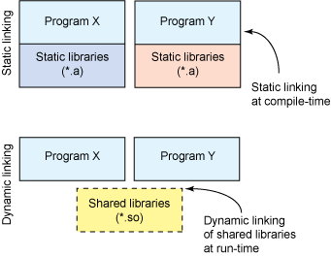
Dynamic Linking: Why Bother?
The executable is typically smaller
When the library is changed, the code that references it does not usually need to be recompiled
The executable accesses the .so at run time; therefore, multiple programs can access the same .so at the same time

Slide 10
Dynamic Linking: Why Bother?
GCC: Code is typically compiled as a dynamic shared object (DSO)
Dynamic v.s. static linking resulting size
$ gcc -static hello.c -o hello-static $ gcc hello.c -o hello-dynamic $ ls -l hello 80 hello.c 13724 hello-dynamic 1688756 hello-static
Notes:
Gcc –static is no longer directly supported in most OSes

Slide 11
Some Disadvantages of Dynamic Linking
Performance hit
Need to load shared objects (at least once)
Need to resolve addresses (once or every time)
Remember back to the system call assignment…
What if the necessary dynamic library is missing?
What if we have the library, but it is the wrong version?

Slide 12
Summary: Static and Dynamic Linking
Static Linking
Cons:
Executable file is large in size
Pros:
Complete and self-contained.
Dynamic Linking
Cons:
Not self-sufficient
Broken when library becomes incompatible
Pros:
The size of executable file is smaller.
No need to re-compile executable file if we update library functions
More efficient mem use when several programs share the lib functions
Notes:
if just one function is changed in a 100K line program, why recompile the whole program? Just recompile the one function and relink.

Slide 13
Static Linking

Slide 14
Commands for Creating Static Library
Create a C file or C files that contains functions in your library
Create a header file or headers for the library
Compile library files (-c to get object files)
gcc -c [your source files] -o [object file(s)]
Create static library. This step is to bundle multiple object files in one static library.
ar rcs [your lib name] [object file(s)]

Slide 15
Using Static Library
Create a c file containing a main function
Compile the source file with
-L[search path] to add the searching path for you static library
-l[library name] to add the static library
gcc -o [executable file] [your source file] -L[path] -l[lib name]

Slide 16
Dynamic Linking

Slide 17
GCC Flags For Creating Dynamic Library
-fPIC:
This flag stands for “Position Independent Code” generation, a requirement for shared libraries. Because it’s impossible to know where the shared library code will be, this flag allows the code to be located at any virtual address at runtime.
-shared:
This flag creates the shared library (shared libraries have the prefix lib and suffix .so

Slide 18
Commands for Creating Shared Library
Create a C file or C files that contains functions in your library
Create a header file or headers for the library
Compiling with Position Independent Code
gcc -c -fPIC [your source files] -o [object file(s)]
Create dynamic library.
gcc -shared -o [your lib name] [object file(s)]

Slide 19
Using Shared Library
Create a c file containing a main function
Compile the source file with
-L[search path] to add the searching path for you static library
-l[library name] to add the dynamic library
gcc -o [executable file] [your source file] -L[path] -l[lib name]
This will cause problem when you run the executable file
Where to load the shared library?
Use -Wl,-rpath=[path] flag: -Wl passes options to linker. -rpath at runtime finds .so from this path.
gcc -o [executable file] [your source file] -L[path] -l[lib name] -Wl,-rpath=[path]

Slide 20
Dynamic Loading

Slide 21
Dynamic Loading
Dynamic loading is a mechanism by which a computer program can, at run time, load a library (or other binary) into memory
How to use?
Adding header file: #include <dlfcn.h>
When compiling your program: add gcc flag: -ldl
In you program using dl APIs

Slide 22
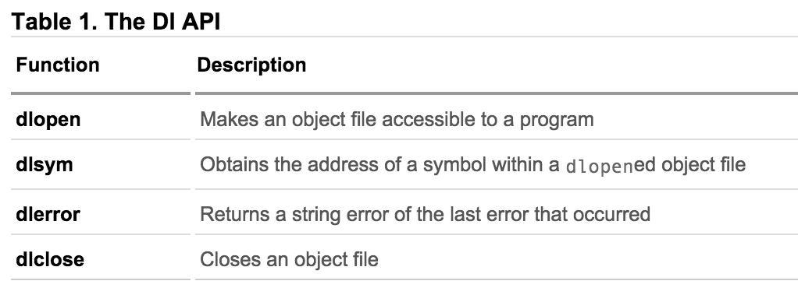
Dynamic Loading APIs

Slide 23
Using LD APIs
Opening Dynamic Library
void* sdl_library = dlopen("libSDL.so", RTLD_LAZY);
if (sdl_library == NULL) { // report error ... }
else { // use the result in a call to dlsym }
Extracting Content from Dynamic Library
void* initializer = dlsym(sdl_library,"SDL_Init");
if (initializer == NULL) { // report error ... }
else { // cast initializer to its proper type and use }
Unloading Dynamic Library
dlclose(sdl_library);

Slide 24
An Example of Using DL
int i = 10;
void (*myfunc)(int *);
void *dl_handle;
char *error;
dl_handle = dlopen("libmymath.so", RTLD_LAZY);//RTLD_NOW
if(!dl_handle) {
printf("dlopen() error - %s\n", dlerror()); return 1;
}
myfunc = dlsym(dl_handle, "mul5"); error = dlerror();
if(error != NULL) {
printf("dlsym mul5 error - %s\n", error); return 1;
}
myfunc(&i);
dlclose(dl_handle);

Slide 25
Attributes of Functions

Slide 26
Attributes of Functions
Used to declare certain things about functions called in your program
Help the compiler optimize calls and check code
Also used to control memory placement, code generation options or call/return conventions within the function being annotated
Introduced by the attribute keyword on a declaration, followed by an attribute specification inside double parentheses

Slide 27
Two Attributes For Your Assignment
__attribute__ ((__constructor__))
This particular GCC syntax, when used with a function, executes the function at the startup of the program, i.e before main() function
__attribute__ ((__destructor__))
This particular GCC syntax, when used with a function, executes the function just before the program terminates through _exit, i.e after main() function.
Example:
__attribute__ ((__constructor__))
void to_run_before (void) {
printf("pre_func\n");
}

